Slide 1
{test1}({lang})
{title}
Created with a trial version of Syncfusion PowerPoint library or registered the wrong key in your application. Click here to obtain the valid key.

Slide 2



{test1}({lang})
Introduce with learners and
ice breaking
Emergency Response
Assembly Point
Location of Wash Room
Tea break and lunch break
Canteen/Cafeteria
Housekeeping and personal hygiene
Special Needs
Mobile Phone

Slide 3
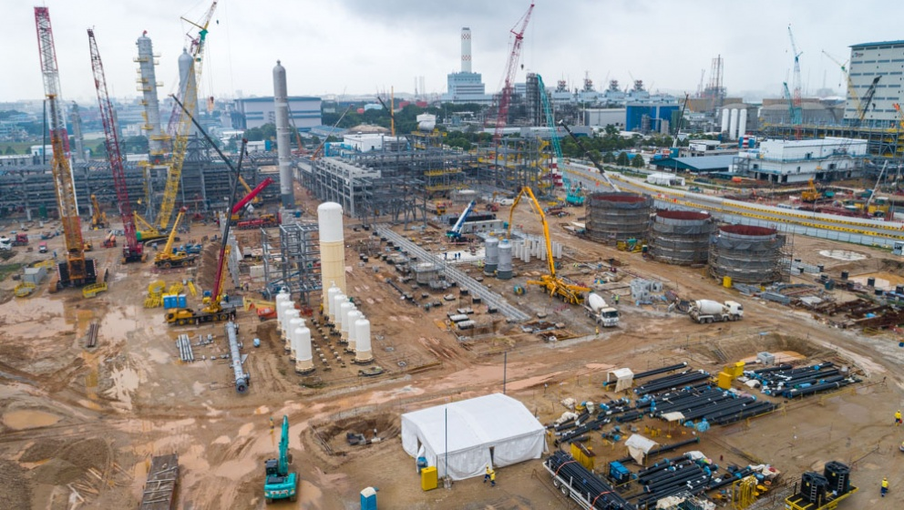
{AbouttheCourse}
{data}
The “Workplace Safety and Health Management in Construction Industry” is a mandatory training course for all persons who going to oversee or supervise any work carried out in a construction worksite safely and without any risk to health.
Course Objectives:
1
2
3
4
5,……

Slide 4
{titletraining}
Written test (Close book, Individual)
{mcqmark} questions ({marks} marks)
Duration: 1 hour
Pass criteria: 60% (Minimum of 24 marks)
Attendance:
{attmark}
Training duration:
{trainingduration}
{submitassement}
Practical Performance
7 stations (PPE, Safety Sign, O2 entry limits for confined space, Fire Emergency, Ascend scaffold, Ascend roof structure and self-relief suspension trauma management)
Pass criteria: 100% (competency based)
> 3 components NYC, considered NYC of the course
Up to 3 components NYC, Trainer will teach and assess learner for 2nd attempt of that (NYC) components. During 2nd attempt, if any 1 component NYC, considered full course NYC.

Slide 5
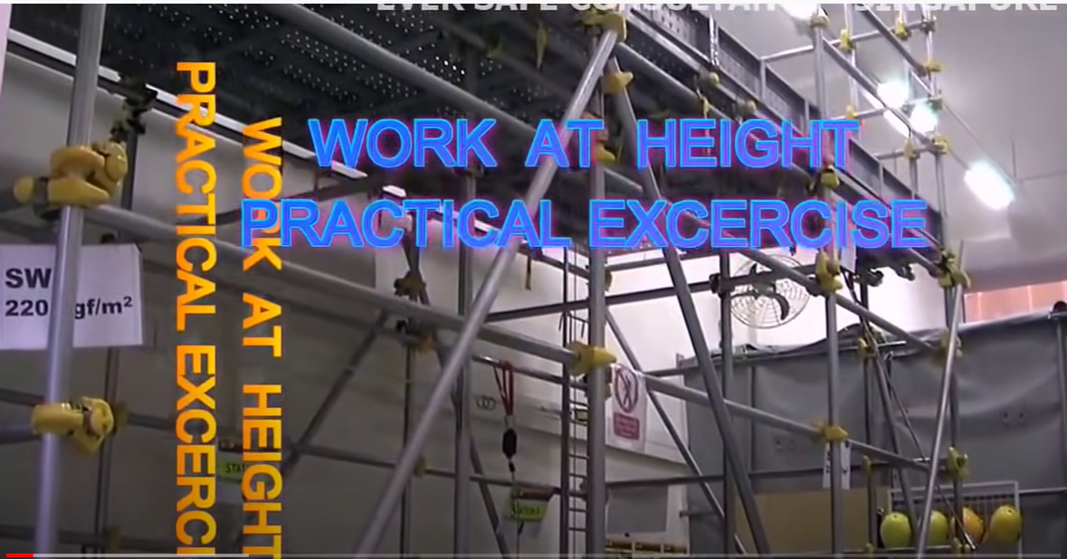
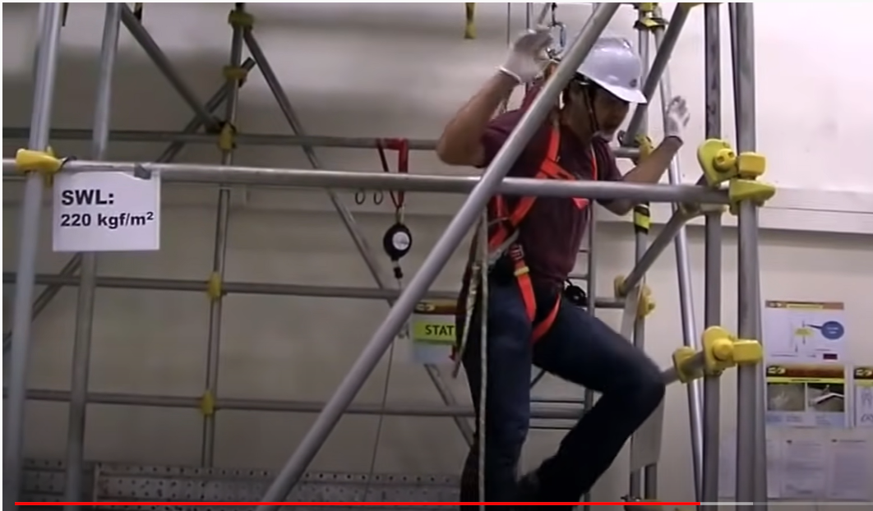
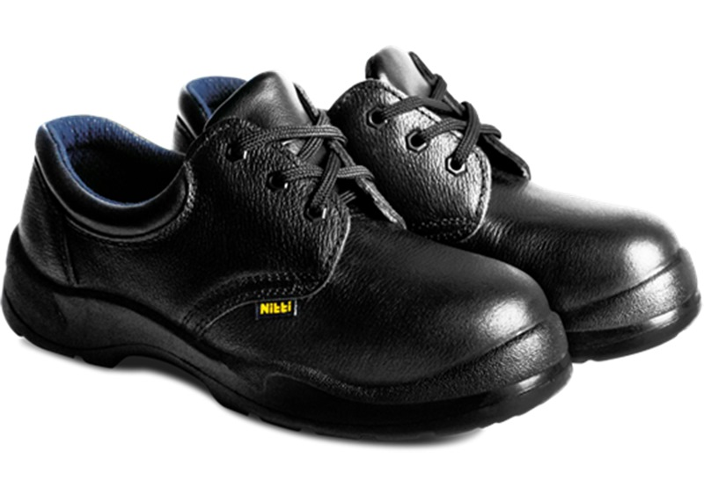
{titletraining}
Trainee must be physically/medically fit to do this course.
Trainee need to declare the physical and Medical fitness in the Indemnity Form.
The course involves theory & practical training and practical examination (Example : Climbing a scaffold structure, Hanging in a Safety Harness etc..)
The trainee MUST BRING “Safety Shoe” and Long Pants for the Practical training and practical examination.
Safety Helmet and Full body Safety Harness will be provided

Slide 6
{projectguide}
Subject: WSH Inspection at own workplace
Submit the soft copy of the project report during Oral Exam.
This Project is a part of Assessment. The Facilitator will review the Project report and justify that this Project is learner’s own work during Oral Exam.
Relate this Project with your actual workplace.
Font: Arial
Font Size: 12
There should be a 5 inspection findings
Submit the project at the last day of class (highly recommended) or must submit within 7 days from the last day of class.
Note:
If fail to submit the project report within time frame, learner need to retake the full course.
If learner fail in project report will be awarded NYC in A5
Project Template will be provided by Eversafe Academy

Slide 7
{examinationrules}
Present at examination venue in time.
Follow the instructions of the invigilator/assessor
Using mobile phone/electronics devises are prohibited during exam. Switch off/silence your mobile phone
Keep your NRIC/Work Permit on the table. Invigilator will check your identity
Remove bags, books, mobile phone or any other personal belongings from the table. Keep in front /behind of the classroom.
Must use pen for written exam and use pencil to shade circle for MCQ exam
Write the question set number on the answer sheet
Learner and Invigilator Signature on the answer sheet
Don’t write/mark anything on the question paper
START and END time will be written on the white board. No extra time will be given for the exam.
Return answer sheet, exam paper and stationery to invigilator
Any types of cheating will not be allowed during exam and if do so by any candidate will be awarded “Zero Mark” or “NYC” immediately
Refer to the “Examination Rules” displayed in the classroom for details

Slide 8

{AssessmentResultandCertificate}
Result will be published at the end of the course and Certificate will be distributed to the Competent learners.

Slide 9

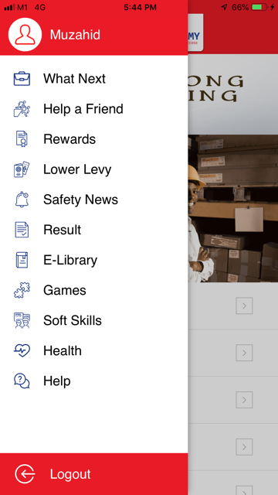

You may check the result from Eversafe App
6
1. Download App
2. Click here
3. Click Result

Slide 10
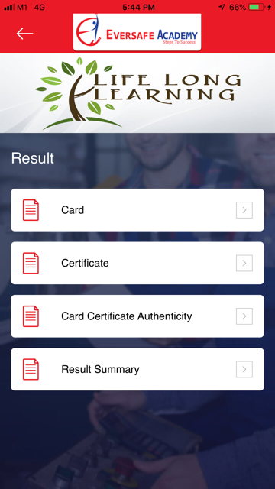

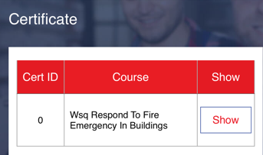
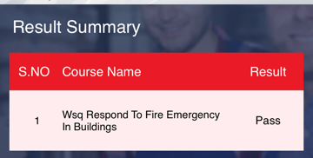
You may check the result from Eversafe App
6
Click
Card > Show
Scan QR Code on Card/Certificate

Slide 12
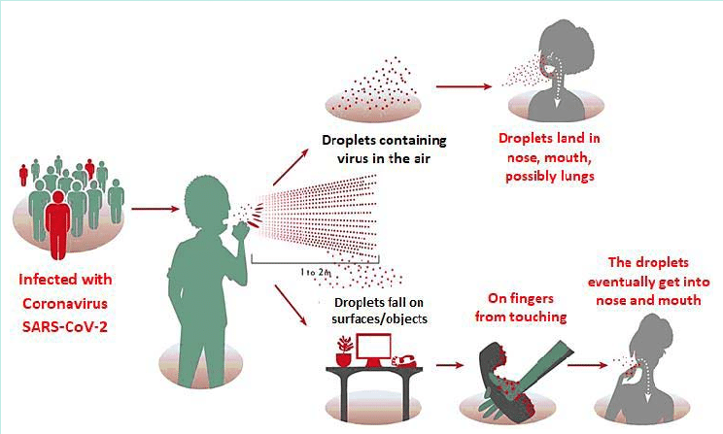
{Introductiontocovid19}
How is it spread?

Slide 13
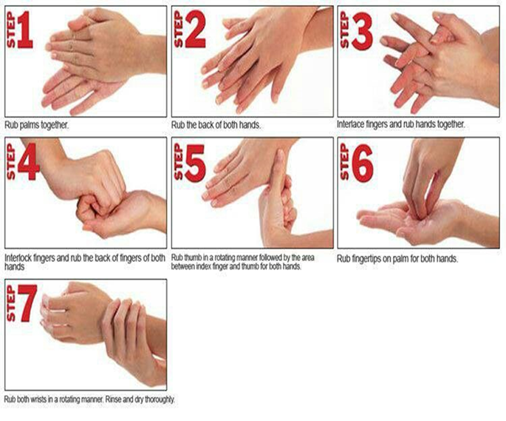
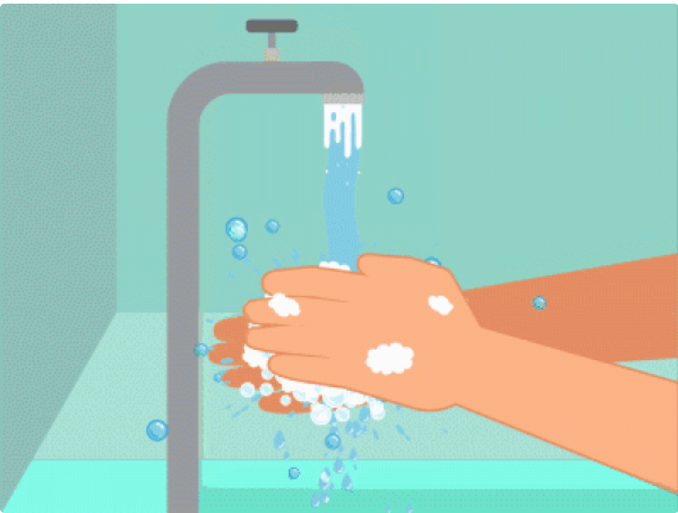
{COVID19SafetyInhouserules}
Ensure MASK is worn all the times
Wash your hands regularly and thoroughly

Slide 14

E- learning – 2 hours
UK 1: Importance of Workplace Safety and Health (WSH)
UK 3: Salient WSH legal and other requirements relevant to construction industry
UK 6: WSH duties and responsibilities of supervisor in the construction industry
Did you complete e-learning study? If not- pls do by today
As a FACILITATOR, I will monitor YOUR e-learning study from “Tracking System” in Trainer login account.
User name and Password will be provided to login in e-learning platform
Visit www.eversafe.com.sg > click login > Choose Blended Learning-Student > Put user name and Password. After login, choose course name

Slide 15


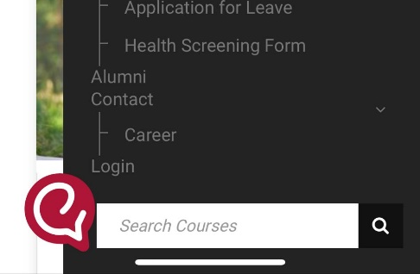
Login to the student’s e-learning portal
Visit www.eversafe.com.sg > click login > Choose Blended Learning-Student >User Name: NRIC/FIN > Show my login link> Go to my page
From computer
From mobile phone
Step 1- go to website “www.eversafe.com.sg”
Step 1- go to website “www.eversafe.com.sg”
Step 1a- click here, scroll down
Step 2- click login
Step 2- Click “Login”

Slide 16
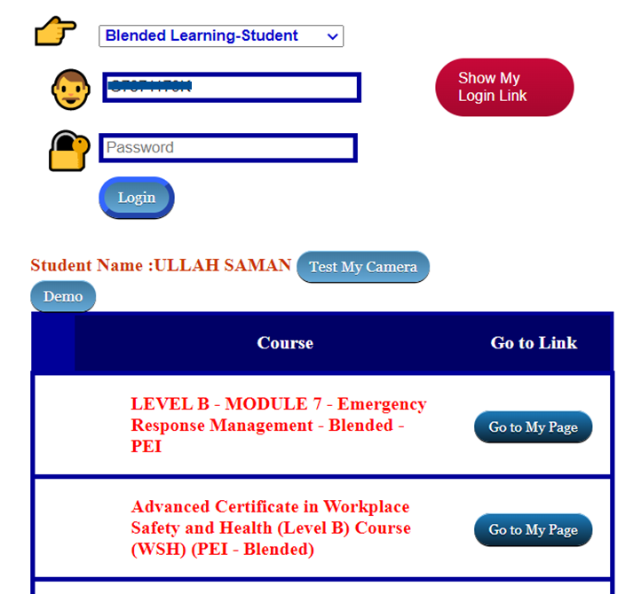
9
Login to the student’s e-learning portal
Visit www.eversafe.com.sg > click login > Choose Blended Learning-Student >User Name: NRIC/FIN > Show my login link> Go to my page
Step 3- click “Blended Learning- Student” from the list
Step 4- write NRIC/FIN
Step 5- click here
Step 6- Check course name and click “Go to My Page”

Slide 17


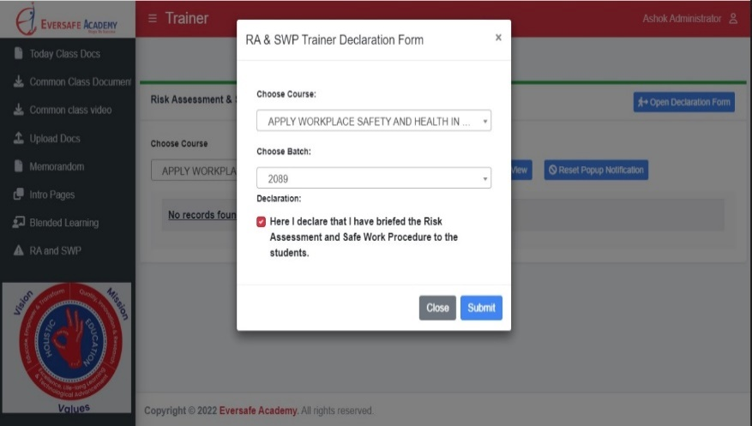



Launch “RA and SWP” from SSTM
10
Trainer to brief RA and SWP to Trainees (RA/SWP)
Go to Teacher-SSTM
Dear Trainer, Please brief practical RA/SWP to Students before lunch time.
System will lock the next session attendance, if you are not done so.
Thank you
1
Click “RA/SWP” tab
Choose Course
Choose Batch ID
Send Notification to all Students after briefing.
2
Student will receive
E-mail or SMS the “Risk Assessment and Safe Procedure Acknowledgement Form”
link, Student will have to
click the “Link” and acknowledge that they have attended the briefing and click “Submit”
www.eversafe.edu.sg

Slide 18
Course Content Summary
 | Performance Statements |  | Underpinning Knowledge
PS1 | jhgfjgsdfgk | UK1 | jyfgsgfkjs
 |  | UK2 | jhfjgskjfskhf
PS2 | shgfhgskfjsjf | UK3 | jhagjhdgajf
 |  | UK4 | jhgjhgkjas
 |  | UK5 | jhgagjf

Slide 19
PS1: Explain and interpret salient WSH legislations and other requirements relevant to construction industry
UK1 Importance of Workplace Safety and Health
1.1 Importance of Workplace Safety and Health (WSH)
1.2 Workplace safety and health reports and statistics
12b

Slide 20
PS1 gjgfjhgskjfhj UK2 tuyrtwy8736o

Slide 21


13
Topic Highlights
Who is responsible for workplace safety if you are working at height?
Who are the person affected if an accident happens?
If you do not wear personal protective equipment (PPE) properly for the first time $----------- may be fined.
If you violate any safety rules/ committed unsafe act _________ penalty will given for the 1st time.
If you violate any safety rules/ committed unsafe act for the 2nd time $----------- may be fined.
How many employees should a workplace safety committee be set up with?
Workplace guardrails/ Barricades should be at least -------- meters high
If your workplace is unsafe you must inform your __________immediately.
__________will conduct the Tool box meeting.
_____________, ________________ are discussed at the Tool box meeting.

Slide 22

Bledned Learning Activity 1 (PTW) (Class Room) (Group Discussion and presentation)
14
Duration: 35 Minutes (Group 3 to 5 members)
Participants will each be given a set of PTW (WAH) form (It is the learner guide)
Participants are required to stimulate the 3 roles when completing the form based on a given WAH situation;
Trainer may guide the students when filling Assessor and Manager part of the permit
Based on the availability of resources, identify a safe means execution and put up the application; and
Facilitator will summarise the learning points.

Slide 23
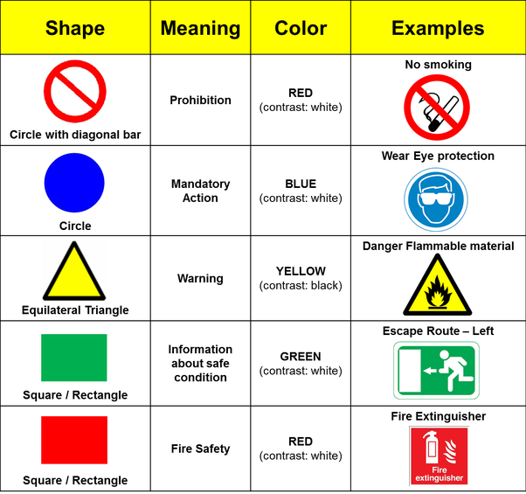
Blended Learning Activity (Home)
14a
You will be given student portal log in Link.
Log in and you can self learn to improve the knowledge on Safety and Health.
.
Duration: 30 Minutes –
Identify the Mandatory Signage
Learning Objectives:
The identify the different types of signages such as Mandatory, Prohibitory, Warning and Safe Condition Signages
To understand the different types of PPE for the work activity
The procedure:
Log in to the EverSafe trainee portal using their your log in ID and Password (Provided by Eversafe).
Identify the Mandatory, Prohibition Sign, Warning Sign, Safe Condition Sign, Fire Signs.
Refer to the picture and click on the right signage for the given work activity.

Slide 24
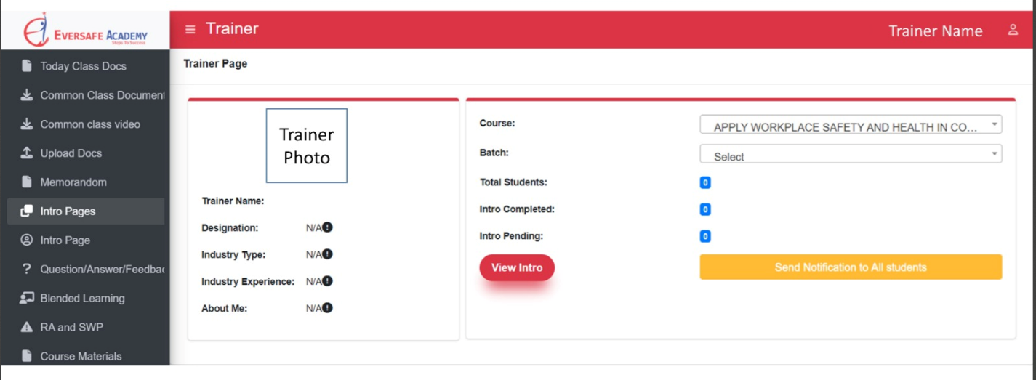

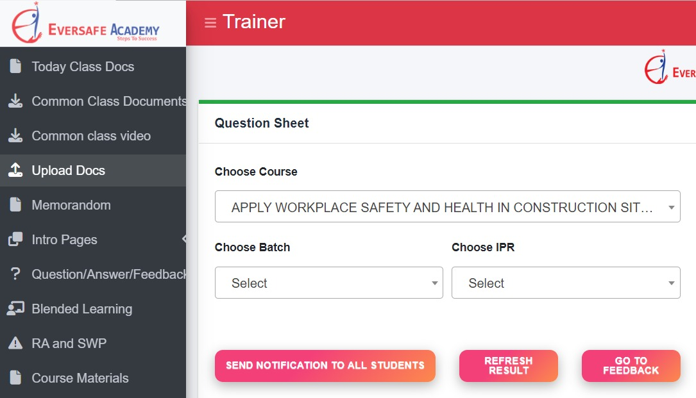
15
Launch “Instant Performance Reflection” from SSTM
INSTANT PERFORMANCE REFLECTION (IPR)
TESTING THE KNOWLEDGE OF THE STUDENT
Go to Teacher-SSTM
Click Intro Pages
Click Intro Page
Choose Course and Batch No to send notification
Click Question/Answer/Feedback
Choose Course, Batch No and IPR
Send Notification to all Students
Student will receive
E-mail or SMS
the Instant Testing Page Notification
link, Student will have to
click the “Link” and answer all the questions and click “Submit”

Slide 25
15a
Please complete the e-learning study by today
FACILITATOR will ensure that learners completed e-learning study...
Start to write project report.....

Slide 26
15b
Day 2
PS4 Identify WSH hazards, evaluate and control risks in construction industry in accordance with risk management process.
UK9 Typical construction activities
UK11 Typical WSH hazards
UK12 WSH control measures
9.1 Legal requirements
9.1.1 Hazards of working at height
9.1.2 Persons falling from height
9.1.3 Control Measures to prevent Falling from Height accidents
9.1.4 Fall prevention plan
9.1.5 Persons struck by objects falling from height
9.1.6 Safety in scaffolds
9.1.7 Safety in ladders
9.1.8 Housekeeping
9.1.9 Roofing and ceiling works, and steel erection

Slide 27
15c
Did you complete
e-learning study?
If you don’t have computer, please communicate with Customer Service to use the e-lab of Eversafe Academy
Please complete the e-learning study by today
Please show me your draft project report...

Slide 28
15d
Please complete the e-learning study by today, those of you not yet done....
FACILITATOR will ensure that learners completed e-learning study...
Submit the project report in time, otherwise you will get NYC.....

Slide 29
Practical Demonstration by Facilitator and Practice by trainees (Stations 1 – 4)
16
Duration: 60 mins
Station 01: Wear PPE
Station 02: Identify common industrial safety signs.
Station 03: State the O2 entry limits for confined space operations.
Station 04: Fire Emergency
Comprising the following components:
1. Follow fire evacuation procedures
2. Identify correct types of fire extinguishers
3. Apply correct techniques to extinguish fire

Slide 30


17
Understanding Total WSH
Notes:
Trainer notes:
Share the course aims with trainees:
This course will help to create awareness for trainees with an overview of Total WSH and to understand the 3 elements Work, Safety and Health and the 6 interactions involved in creating a healthy workforce and a safe workplace.
Explain briefly what Total WSH encompass:
Manage the interactions between Work, Safety and Health for a healthy workforce in a safe workplace
Address the cross-linkages of people, process and programmes in a company with regards to the implementation of Total WSH
Note: Mention that implementation of Total WSH would be conducted for Manager and WSH Personnel Level workforce which is not covered in this training
In short, Total WSH means “Looking at Work, Safety and Health so as to achieve the well-being of workers”

Slide 31
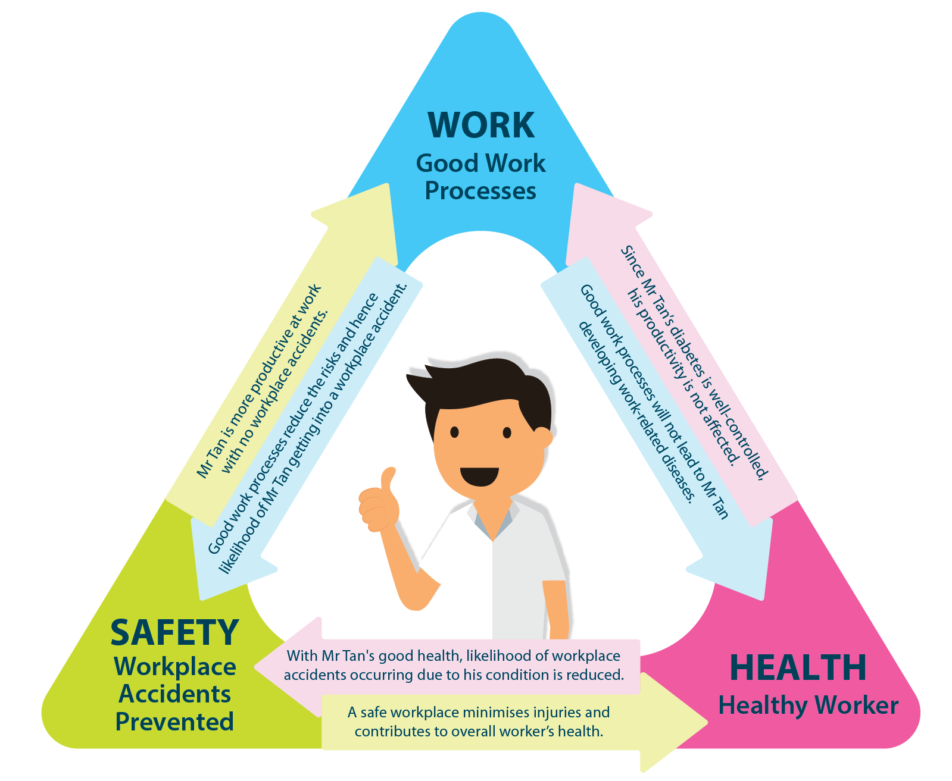
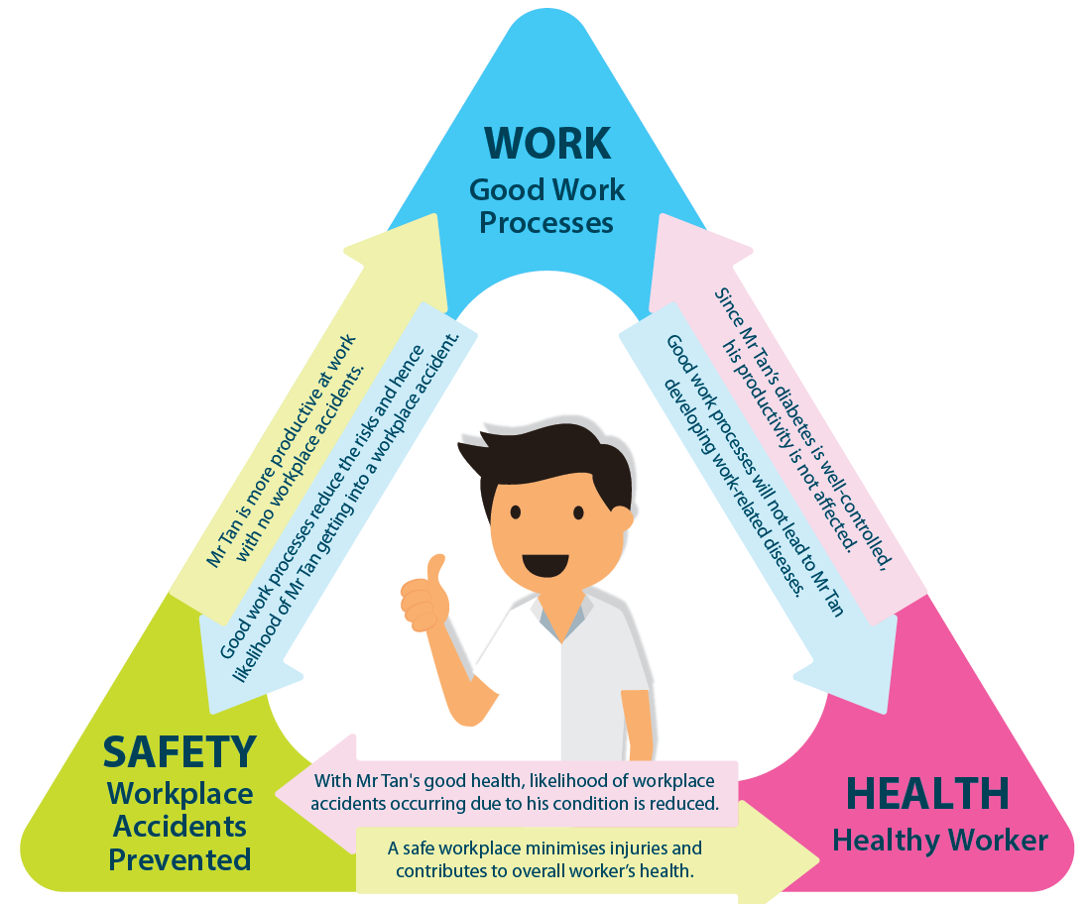
The Total WSH Model
17
Increase productivity
Reduce absenteeism
Reduce accidents at work
Reduce ill-health at work
Healthier workforce,
Safer workplaces
Fewer injuries, better health
Notes:
Trainer notes:
Highlight Total WSH Model on the close interaction of 3 elements – Work, Health and Safety
Mention a total 6 interactions/permutations between 2 elements and emphasise the outcomes as follow:
Work – Good Work Processes
Health – Healthy Worker
Safety – Prevention of Workplace Accidents

Slide 32
Definition of the 3 elements
17
WORK
Refers to productivity and the hazards, environment, nature and demands of the job
SAFETY
Refers to accidents at the workplace
HEALTH
Refers to the well-being of the worker
Notes:
Trainer notes:
Define the 3 elements of Work, Safety and Health
Work – Emphasise that workplace productivity can be affected by hazards, environment, nature and demands of the job. Thus, workers need to be aware of these factors. Encourage workers to highlight to management if they encounter the related issues.
Safety – Mention that workers and supervisors should do risk assessment to identify hazards and include risk control measures at the workplace
Health – Highlight the importance of worker’s well-being which includes mental well-being which is part of our personal health

Slide 33
Interaction 1 – How does Health impact Work
17
HEALTH
WORK
This interaction refers to the effect of worker health on workplace productivity
Positive:
A healthy worker has less sickness absence and more workplace productivity
Negative:
A worker with unassessed/uncontrolled disability/medical conditions increases sickness absence and reduces workplace productivity
Notes:
Trainer notes:
Explain how our Health may affect our Work/Workplace productivity via examples:
Positive example – Healthy worker means less MCs and work items/project would be carried out on schedule which result in higher work/workplace productivity
Negative example – Sick/unwell worker with frequent absence from work may affect the accessibility or availability, thus the work or project under affected worker may lead to delayed project outcomes and thus reduce the work/workplace productivity.
Provide more relevant case example, where applicable.

Slide 34
Interaction 2 – How does Work impact Health
17
HEALTH
WORK
This interaction refers to the effect of work hazards, processes, demands and the work environment on worker health (e.g. Occupational Diseases, Work related diseases etc.)
Positive:
A safe work environment with control of work hazards, reasonable work demands and safe work processes protects worker health
Negative:
An unsafe work environment with poorly controlled work hazards, unreasonable work demands and unsafe work processes is harmful to worker health
Notes:
Trainer notes:
Explain how our Work may affect our Health in terms of occupational disease (e.g. dermatitis or skin disease) via examples:
Positive example – Safe work environment (e.g. hierarchy of risk control measures, proper workload management and safe work procedures) help protect health and safety of worker when dealing with chemicals/fumes, as an example.
Negative example – Conversely, an unsafe work environment (e.g. poor design of workplace layout), unsafe work processes (e.g emission of fumes without proper local exhaust ventilation) and poor workload management (e.g unreasonable timeline and allocation) – can affect worker’s health (e.g. mental well-being) and worsen pre-existing condition, if any.

Slide 35
Interaction 3 – How does Safety impact Health
17
SAFETY
HEALTH
This interaction refers to the impact of workplace accidents on worker health
Positive:
The absence of workplace accidents protects worker health
Negative:
Workplace accidents are harmful to worker health
Notes:
Trainer notes:
Explain how Workplace Safety impact our Health via examples:
Positive example – Proper risk assessment with identification of hazards and risk control measures can mitigate the risks to prevent ill-health, injury and workplace incident – Protects worker’s safety and health
Negative example – Insufficient or no risk assessment will lead to more workplace accidents which result in injuries and affect worker’s health or worsen worker’s pre-existing condition, if any.

Slide 36
Interaction 4 – How does Health impact Safety
17
SAFETY
HEALTH
This interaction refers to the disability or medical condition of the worker having an effect on the causation of workplace accidents.
Positive:
A healthy worker is less likely to cause workplace accidents
Negative:
A worker with unassessed/uncontrolled disability/medical conditions is more likely to cause workplace accidents
36
Notes:
Trainer notes:
Explain how our Health can affect Workplace Safety via examples:
Positive example – A healthy worker or worker with well-controlled pre-existing medical condition (eg with stringent observance of health measures) will less likely cause workplace accidents.
Negative example - Conversely, a worker with pre-existing condition but without proper control (eg no regular health review or medication) will not be fit and alert at work and may cause potential workplace accidents to take place

Slide 37
Interaction 5 – How does Work impact Safety
20
WORK
SAFETY
This interaction refers to the effect of work hazards, processes, demands and the work environment on the causation of workplace accidents
Positive:
A safe work environment with control of work hazards, reasonable work demands and safe work processes is less likely to cause workplace accidents
Negative:
An unsafe work environment with poorly controlled work hazards, unreasonable work demands and unsafe work processes is more likely to cause workplace accidents
37
Notes:
Trainer notes:
Explain how our Work can affect Workplace Safety via examples:
Positive example: Organisation need to provide safe working environment conducive for work. These include implementation of risk control measures of identified hazards and safe work procedures for work activities, with worker’s participation on the project timelines.
Negative example: Conversely, a poor managed work environment with insufficient or no risk assessment, unsafe work practices and unreasonable timeline (set by management) or overwhelming work demands will result in unnecessary stress (eg psychosocial) to workers, resulting in more workplace accidents.

Slide 38
Interaction 6 – How does Safety impact Work
20
WORK
SAFETY
This interaction refers to the impact of workplace accidents on workplace productivity
Positive:
The absence of workplace accidents preserves workplace productivity
Negative:
Workplace accidents decrease workplace productivity
Notes:
Trainer notes:
Explain how Workplace Safety can affect our Work via examples:
Positive example: Organisation can prevent occurrence of workplace accidents with risk control measures (e.g. implementation of effective WSH management system). This will result in safe execution of project or work activities, thereby maintaining or upholding workplace productivity.
Negative example: On the other hand, a workplace with frequent workplace accidents will affect worker’s morale and work performance, thus lowering the workplace productivity.

Slide 39

Example 1: Without Total WSH
20
WORK
Poor Work Processes
i6
i1
An increase in workplace accidents causes a decrease in Mr Tan’s productivity
Due to Mr Tan’s uncontrolled diabetes, he has frequent sickness absences that decrease his work productivity
i5
i2
Poor work processes result in Mr Tan taking shortcuts, compromising safety and cause a workplace accident
Poor work processes causes Mr Tan experiences unnecessary stress that worsens his control of diabetes
SAFETY
i3
A workplace accident results in Mr Tan getting injured at work, aggravating his diabetes
HEALTH
Workplace Accidents
Poorly Controlled Diabetes
i4
Mr Tan’s poorly controlled diabetes causes giddiness at the workplace, resulting in another workplace accident
Notes:
Trainer notes:
Illustrate the effect of workplace without Total WSH using worker Mr Tan as an example in a clockwise manner.
Work and Health
Shared Mr Tan’s health condition (eg diabetes without medical attention or other control) where he is absent from work frequently due to poor disease management, as the starting point . This may affect workplace communication and result in lowered work/workplace productivity
Lack of organization’s care and poor management of work processes further add unnecessary stress to Mr Tan’s diabetic condition
Health and Safety
Due to poor control of diabetic condition, Mr Tan experiences frequent giddy spells at the workplace, which causes him to fall and result in a workplace accident. This further worsens his health condition and affects the ability to recover from injury.
Safety and Work
Mention that as a result of poor work process management which fail to address worker’s at-risk behaviour, Mr Tan took short cuts at work without safety consideration, and results in another workplace accident. More accidents affect the organization’s WSH record which affects Mr Tan’s/workplace’s productivity

Slide 40

Example 2: With Total WSH
20
WORK
Good Work Processes
i6
i1
The absence of workplace accidents preserves Mr Tan’s productivity at work
Since Mr Tan’s diabetes is well controlled, his productivity is not affected
i5
i2
Good work processes lowers the possibility of Mr Tan getting into a workplace accident
Good work processes does not cause unnecessary stress for Mr Tan, thus not aggravating his diabetic control
SAFETY
i3
The absence of workplace accidents prevents Mr Tan’s diabetes from worsening
HEALTH
No
Workplace Accidents
Well
Controlled Diabetes
i4
Since Mr Tan’s diabetes is well controlled, the likelihood of workplace accidents occurring due to his medical condition is decreased
Notes:
Trainer notes:
Illustrate the effect of workplace with Total WSH using worker Mr Tan as an example in a clockwise manner.
Work and Health
Mention that we used the same worker Mr Tan with diabetic condition but with proper control of his pre-existing health condition. As such, due to precautions adopted by Mr Tan (e.g. regular health review and careful diet) Mr Tan does not need to take MC and thus maintain his work productivity
Organisation’s good work processes management such as proper planning of workload schedule does not add further stress to Mr Tan’s diabetic condition
Health and Safety
By observing stringent health measures, Mr Tan’s diabetic condition is well under control. He can work diligently without feeling giddy or suffering from other health concerns. Thus, there is better control of workplace safety with reduced likelihood of occurrence of workplace accident.
Safety and Work
Good work processes management allow Mr Tan to follow proper Safe Work Procedure with lowered risk of injury. Mr Tan can work safely and continue to uphold his/workplace productivity

Slide 41

Benefits of Total WSH for your company
20
Notes:
Trainer notes:
Mention the benefits (non-exhaustive) would help an organization to become a healthy workforce and safe workplace as follow:
Lowered absenteeism and reduced healthcare costs due to lesser number of workers falling sick or taking MC
Enhanced worker and employer relation build upon care and trust in management
Increase workplace productivity and more revenue generation due to better business performance
Lower staff turnover due to better morale and job/workplace satisfaction

Slide 42
20
Call To Action….
Take Time to Take Care
3 Ways to create a Healthy Workforce
Stay active and eat healthy
Sleep well (enough rest)
Exercise regularly and manage your health
Watch video ‘How You Work Is How You Live’
Notes:
Trainer notes:
Mention it’s time for workers to take up constructive actions to adopt a Total WSH approach at personal level
Remind workers to Take Time to Take Care by observing 3 ways to create a healthy workforce:
Stay active and eat healthy
Sleep well (enough rest to recover)
Exercise regularly and manage your health
Work with immediate supervisor to share any workplace issues, if any, and discuss the appropriate solutions to address these issues

Slide 43
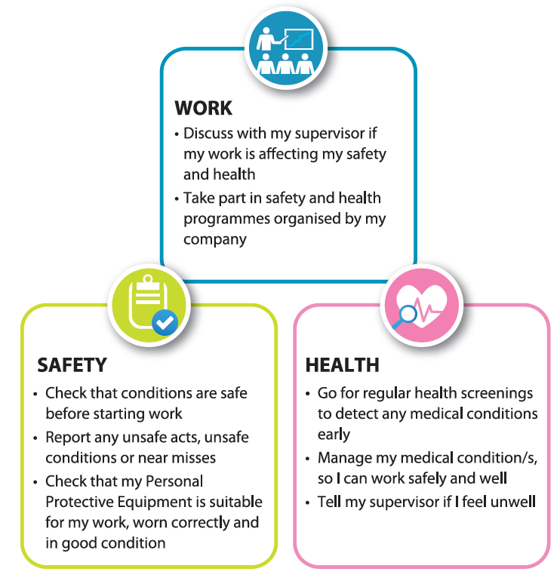
What can you do as an employee?
17

Slide 44
18
Question
&
Answer
44

Slide 45
FUNDING AVAILABILITY
19
S.NO | SKILLSFUTURE CREDIT | SKILLS DEVELOPMENT FUNDING | WORK FORCE TRAINING SCHEME | UTAP (for NTUC Members)
1 | SkillsFuture Credit is for all Singaporeans aged 25 and above. 2. Should have achieved at least 75% attendance; | 1.Aaged 21 years and above. 2. Should have achieved at least 75% attendance; | 1.Be a Singapore Citizen; and 2.Aged 35 years and above (13 years and above for Persons With Disabilities); and 3.Earn a monthly income of not more than $2,000. | 1.You can apply for UTAP as long as you are an NTUC member 2.UTAP funding is only applicable on the course fee not funded through company sponsorship or other types of funding 3.Course fee support for up to $250 each year training benefits for courses under Union Training Assistance Programme (UTAP) per year
2 | (Singaporeans Only). | (Singaporeans and Singapore PR only) | (Singaporeans Only). | All NTUC member (Including Migrant worker)

Slide 46

20

Slide 47
21
Version Control History
EXTERNAL AUTHORITY | EA
Ref.Document | Version | Revision | Effective Date | Author | Approved | Change Description
First Issue | 1.00 | 00 | 15/07/2018 | EA | EA MD | First Issue- Applied Blended Learning Methods
 | 1.01 | 01 | 30/04/2019 | EA | EA MD | added Slip, trip and fall slides provided by WSHC.
 | 1.02 | 02 | 14/07/2020 | EA | EA MD | Routine Review and checked the currency, updated statistics
 | 1.03 | 03 | 01/09/2020 | EA | EA MD | Incident Reporting Amendment Regulations and WICA updated
 | 1.04 | 04 | 01/08/2021 | EA | EA MD | The word “Foreign” changed to “Migrant”
 | 1.05 | 05 | 14/01/2022 | EA | EA MD | “Total WSH Contents” information is added
 | 1.06 | 06 | 15/4/2022 | EA | EA MD | Amended as Per the new WSH Council TAG, Ver 2.0 Published date 21 Jan 022
 | 1.07 | 07 | 1/8/2022 | EA | EA MD | Amended to include all blended learning methods and training hours adjusted
Created with a trial version of Syncfusion PowerPoint library or registered the wrong key in your application. Click here to obtain the valid key.

